Slide 1

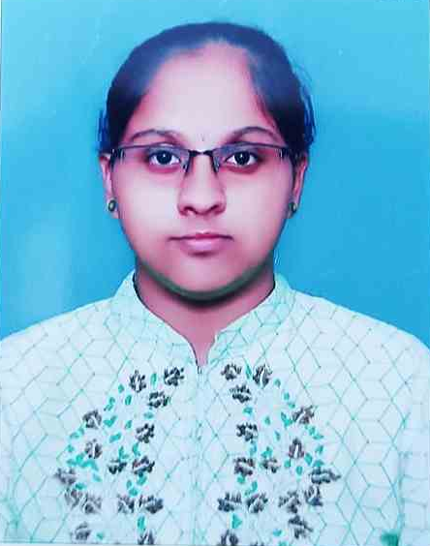
CAPSTONE PROJECT
AgriSmart
An AI-Based Smart Agriculture Assistant
Presented By
Student Name: B. TRISHA PRANATHI
College Name: PALLAVI ENGINEERING COLLEGE
Department: COMPUTER SCIENCE ENGINEERING(CSE)
Email ID: trishapranathi@gmail.com

Slide 2
OUTLINE:
Problem Statement (Should not include solution)
Proposed System/Solution
System Development Approach (Technology Used)
Algorithm & Deployment
Result (Output Image)
Conclusion
Future Scope
References

Slide 3
Problem Statement:
Agriculture is one of the most important sectors for economic growth and food security. However, farmers face significant challenges due to lack of access to expert knowledge and data-driven decision-making tools.
Farmers often select crops based on traditional practices rather than scientific analysis.
Soil nutrient imbalance leads to poor crop yield.
Identifying plant diseases at early stages is difficult without expert assistance.
Incorrect disease diagnosis can result in improper treatment and crop loss.
Agricultural experts are not easily accessible in rural areas.
Manual monitoring of crops is time-consuming and inefficient.
These challenges lead to reduced productivity, financial losses, and inefficient farming practices, highlighting the need for intelligent systems to assist farmers.

Slide 4
Proposed Solution:
The proposed system is an AI-powered web application that assists farmers by providing intelligent crop recommendations and automated disease detection.
System Modules:
1. Crop Recommendation System
Takes soil and environmental parameters as input.
Uses machine learning to suggest the most suitable crop.
2. Plant Disease Detection System
Allows users to upload plant leaf images.
Uses deep learning to detect diseases.
Key Features:
Real-time prediction using trained models
User-friendly web interface
Fast and accurate results
Reduces dependency on agricultural experts
The system enables farmers to make informed decisions and improve crop productivity.

Slide 5
System Approach:
Hardware Requirements:
Processor: Intel i5 or above
RAM: 8 GB or higher
Storage: Minimum 10 GB free space
Software Requirements:
Programming Language: Python 3.x
IDE: VS Code / Jupyter Notebook / Google Colab
Operating System: Windows / Linux

Slide 6
System Approach:
Libraries & Frameworks:
NumPy – Numerical computations
Pandas – Data manipulation
Matplotlib / Seaborn – Visualization
Scikit-learn – Machine Learning models
TensorFlow / Keras – Deep Learning
Flask – Web Framework
System Integration:
Frontend (HTML, CSS, JavaScript) collects user input
Backend (Flask) processes requests
ML models generate predictions
Results are displayed on web interface

Slide 7
Algorithm & Deployment:
1. Crop Recommendation Algorithm
The crop recommendation system is developed using a supervised machine learning classification approach to predict the most suitable crop based on soil and environmental parameters.
Input Features:
Nitrogen (N)
Phosphorus (P)
Potassium (K)
Temperature
Humidity
pH Value
Rainfall
Algorithm Used: Random Forest Classifier
Random Forest is an ensemble learning technique that combines multiple decision trees to improve prediction accuracy.
Working Process:
The dataset is collected and cleaned.
Features are selected and normalized.
Dataset is split into training and testing sets (80:20).
Multiple decision trees are trained on random subsets of data.
Each tree predicts a crop label.
Final prediction is determined by majority voting.

Slide 8
Algorithm & Deployment:
2. Disease Detection Algorithm
The disease detection system uses Deep Learning (CNN - Convolutional Neural Network) for image classification.
Input:
Leaf image uploaded by the user
CNN Architecture Workflow:
Image Input Layer
Image resized (e.g., 224x224)
Pixel normalization
Convolution Layer
Extracts features such as edges, shapes, textures
Activation Function (ReLU)
Introduces non-linearity
Pooling Layer
Reduces dimensionality
Flatten Layer
Converts 2D feature maps into 1D vector
Fully Connected Layer
Learns complex patterns
Output Layer (Softmax)
Classifies disease category

Slide 9
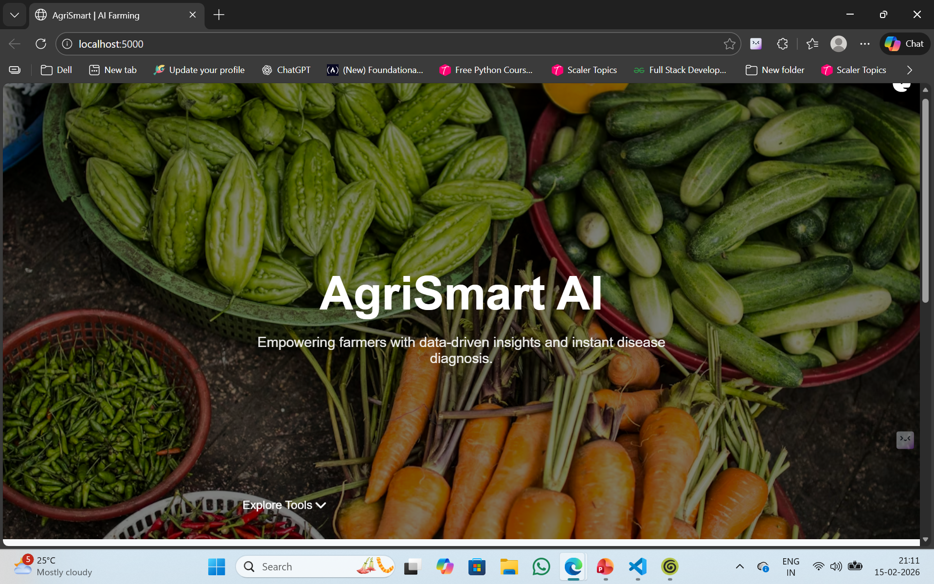
Result:
Loading page

Slide 10
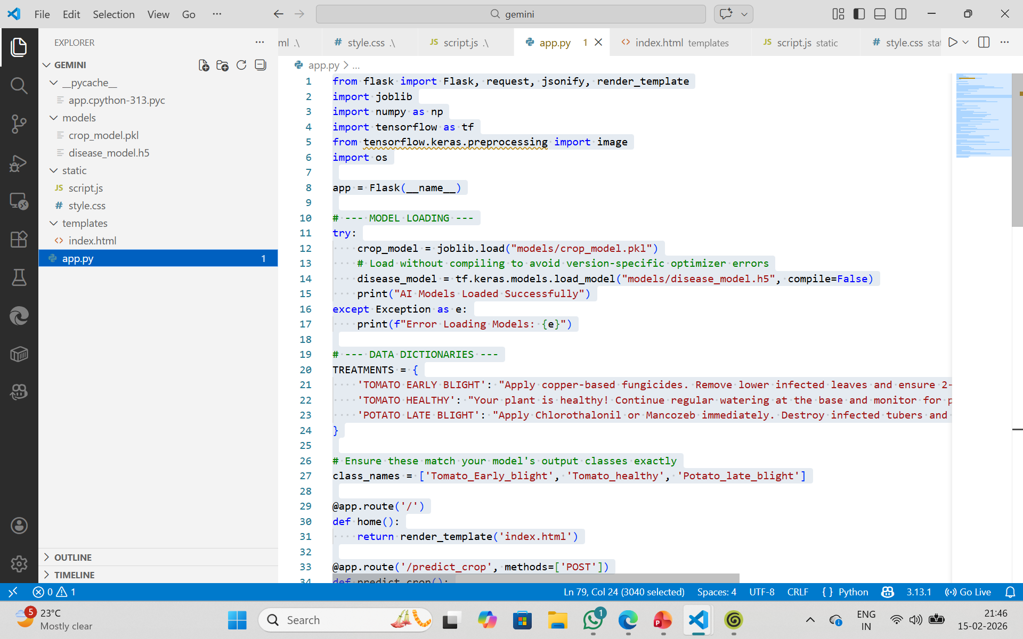
Result:
App.py code

Slide 11
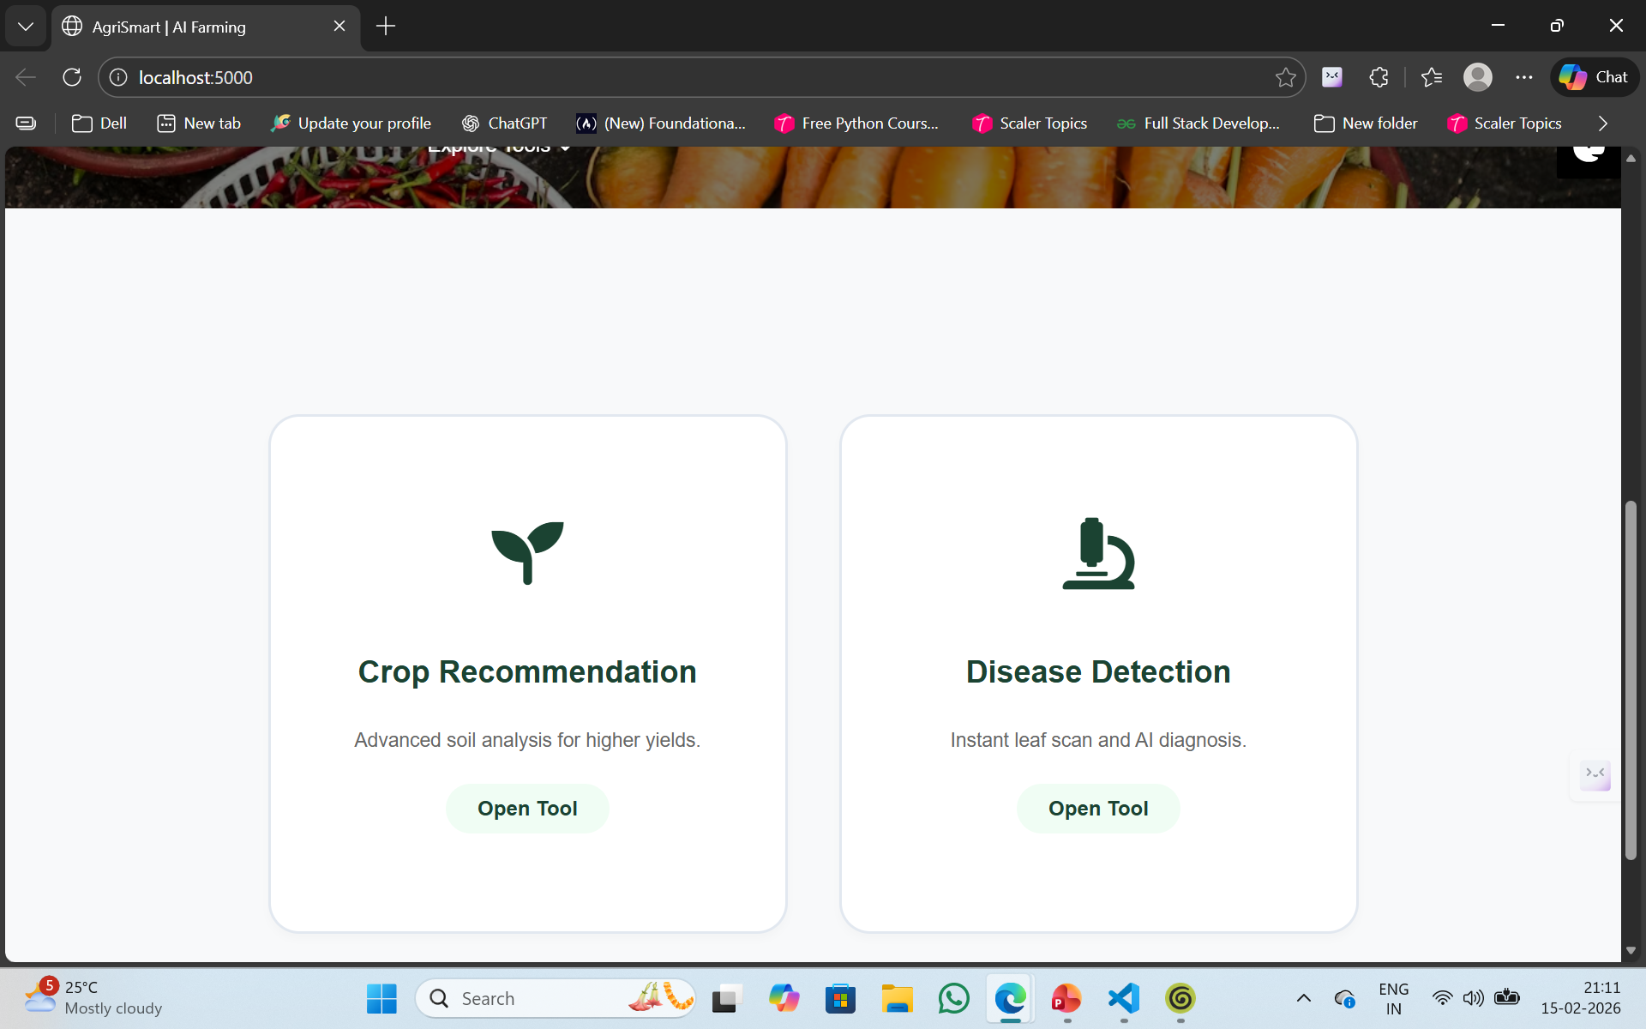
Result:
Modules Featured

Slide 12
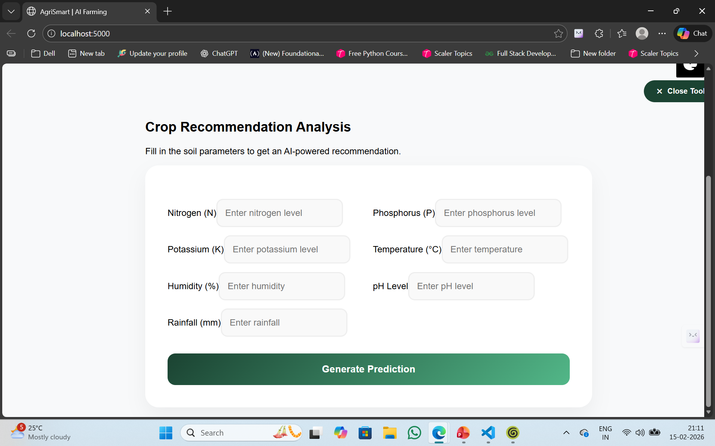
Result:
Crop recommendation

Slide 13
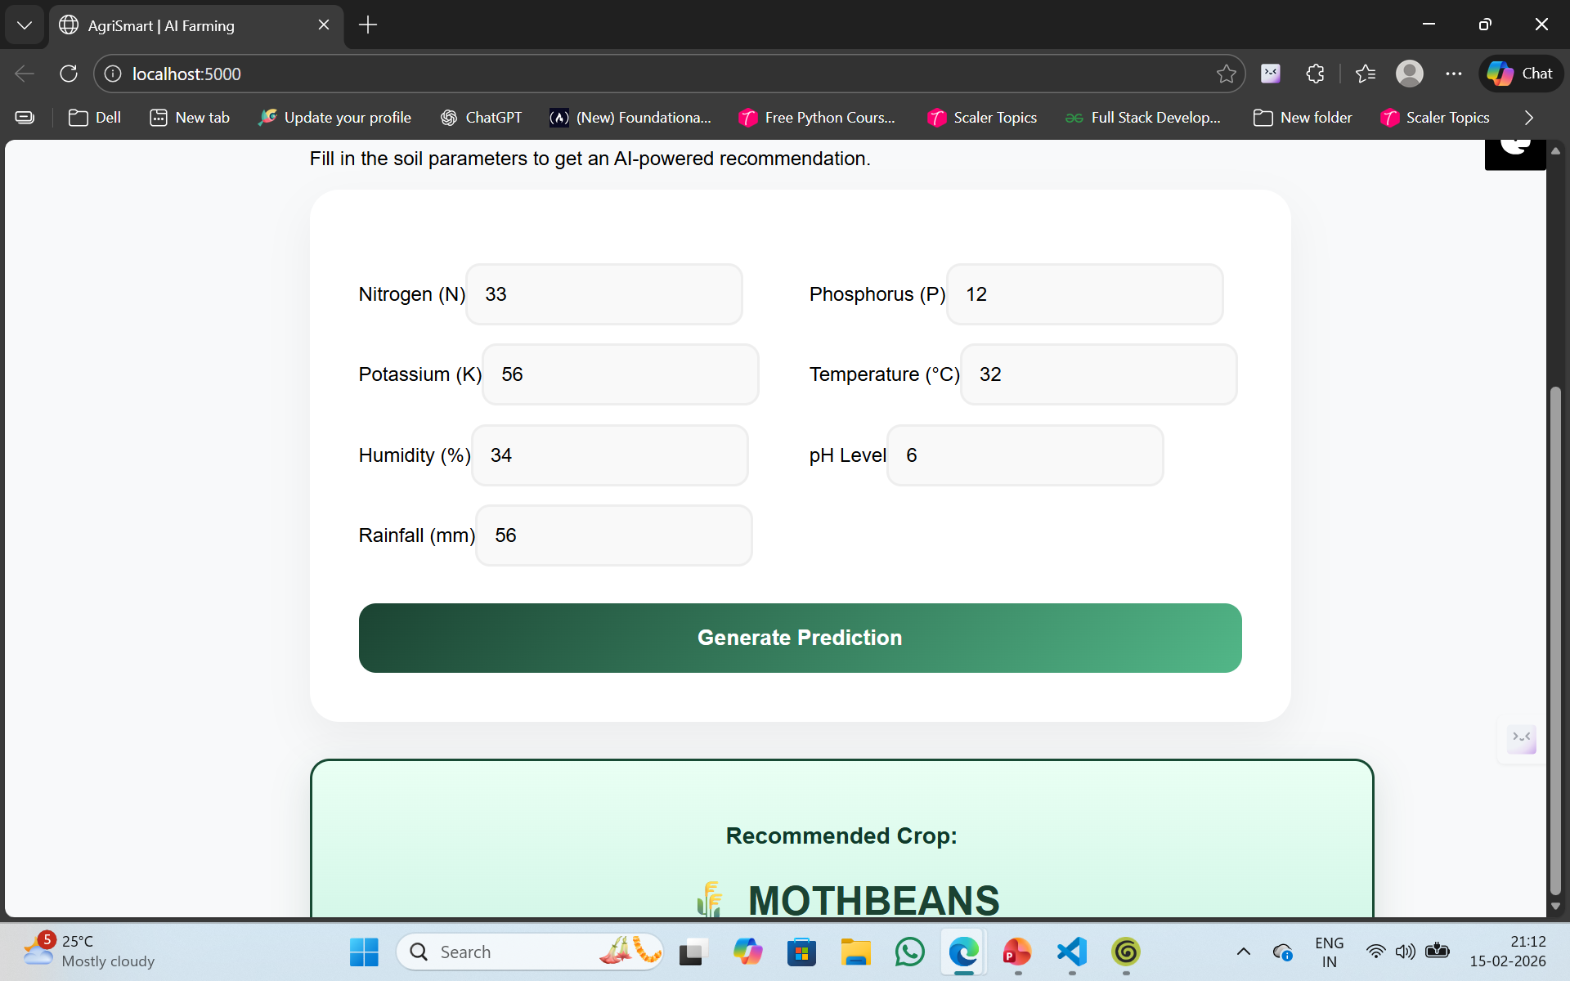
Result:
Analysis Result

Slide 14
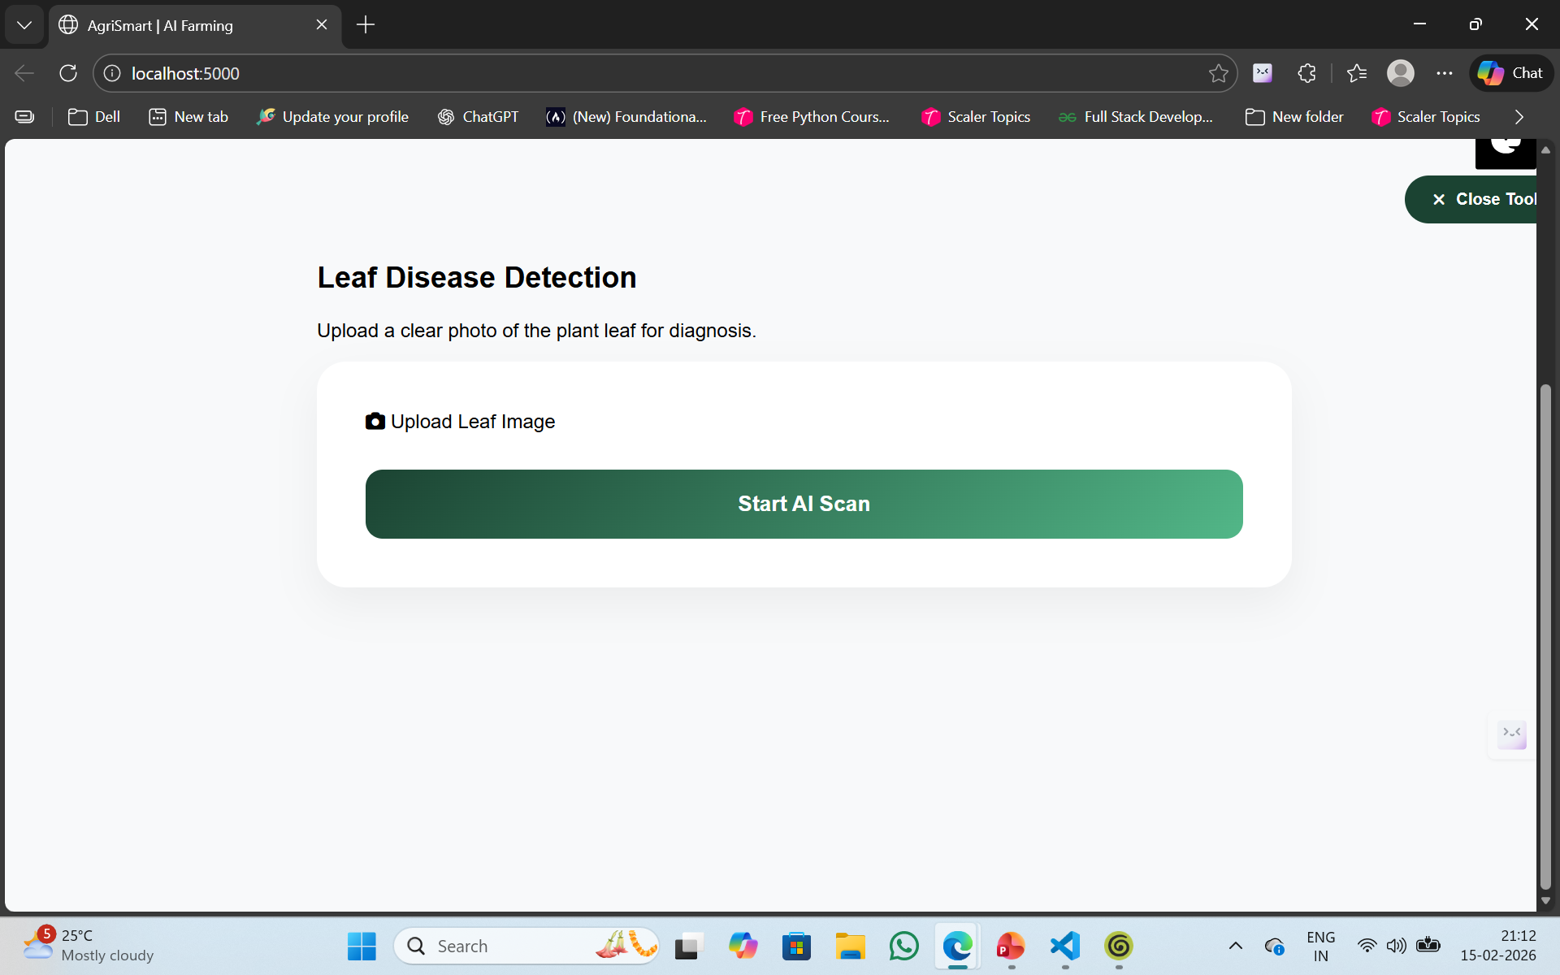
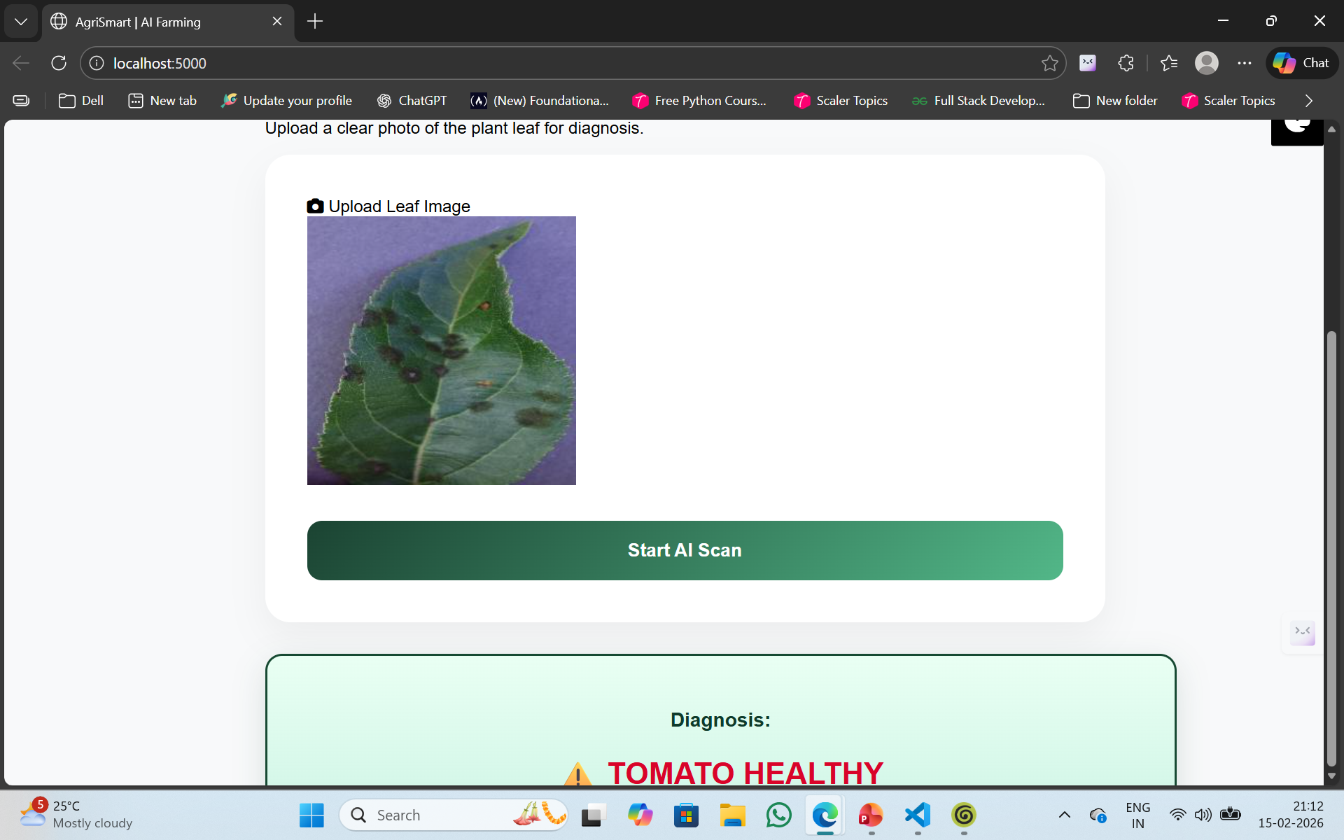
Result:
Disease detection

Slide 15
Result:
Detection result

Slide 16
Conclusion:
The project presents an AI-based Smart Agriculture Assistant that uses Machine Learning and Deep Learning techniques for crop recommendation and plant disease detection. The system provides accurate and real-time predictions through a user-friendly web application. It helps farmers make data-driven decisions, enables early disease identification, and reduces dependency on expert guidance. Overall, the project demonstrates the potential of Artificial Intelligence in improving agricultural productivity and promoting smart farming practices.

Slide 17
Future scope:
Integration of real-time weather data for dynamic crop prediction
Expansion of dataset to improve model accuracy and coverage
Development of mobile application for easy field access
Multi-language support for better farmer usability
IoT integration for automatic soil data collection
Cloud deployment for scalability and remote access
Fertilizer and treatment recommendations for better crop management
Use of advanced AI models for improved performance

Slide 18
References:
Kaggle Datasets :
Crop Recommendation Dataset: https://share.google/azdNJ9lPinZacgwIh
Disease detection Dataset: New Plant Diseases Dataset
GitHub Link: 3sha507/AgriSmart_Azure

Slide 19
Thank You

